Slide 1
Lecture 11: Loops
CSC111: Introduction to CS through Programming
R. Jordan Crouser
Assistant Professor of Computer Science
Smith College

Slide 2
Debrief of first few coding assignments (1/2)
Overall: really solid!
Strengths:
nicely formatted submissions
informative variable names
great use of comments (particularly for leaving “notes” and making sections for individual components)
Still working on:
balancing matching specs vs. being creative
sketching out a plan before you start coding
Some tips:
use blank lines to separate “logical chunks” of code (like paragraphs)
Python automatically ignores blank lines! (no need to comment)

Slide 3
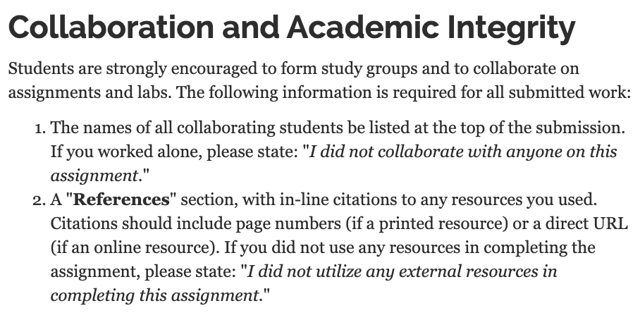
Debrief of first few coding assignments (2/2)
Reminder:

Slide 4
Debrief of first few coding assignments (2/2)
Reminder:

Slide 5
Overview
Announcements
Monday: Loops
for…in (looping through items in a list)
the range() function (getting a list of numbers)
while (looping until something happens)
Lab: Loops
Wednesday: Life Skill #2/3: Debugging & Documentation
Friday: Dictionaries and Sets

Slide 6
Reality: online classes can be rough

Slide 7
Activity: Beats

Slide 8

Discussion
What kinds of repetition did
you notice?

Slide 9
Loops: a familiar idea
https://xkcd.com/1411/

Slide 10
Loops in computer programming
Goal: simplify the description of repeated blocks of code (i.e. make it shorter/easier to understand by highlighting what’s being repeated and for how long)
Three approaches:
run for each item in a list
run a specific number of times
run until some condition is met

Slide 11
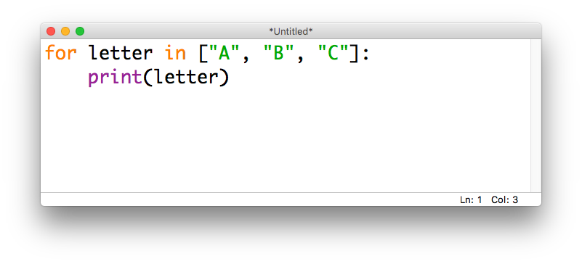
for...in loops
In Python, we use the keywords for and in to loop through a list

Slide 12
for...in loops
We can think of this in terms of where the variable letter is pointing:

Slide 13
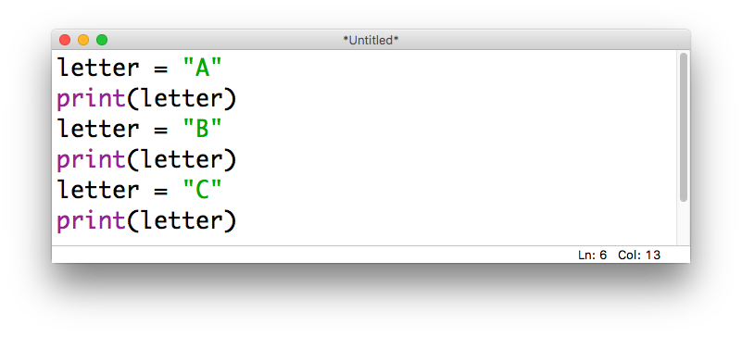
for...in loops: unpacked
We could accomplish the same thing by writing it out as three separate assignments:

Slide 14
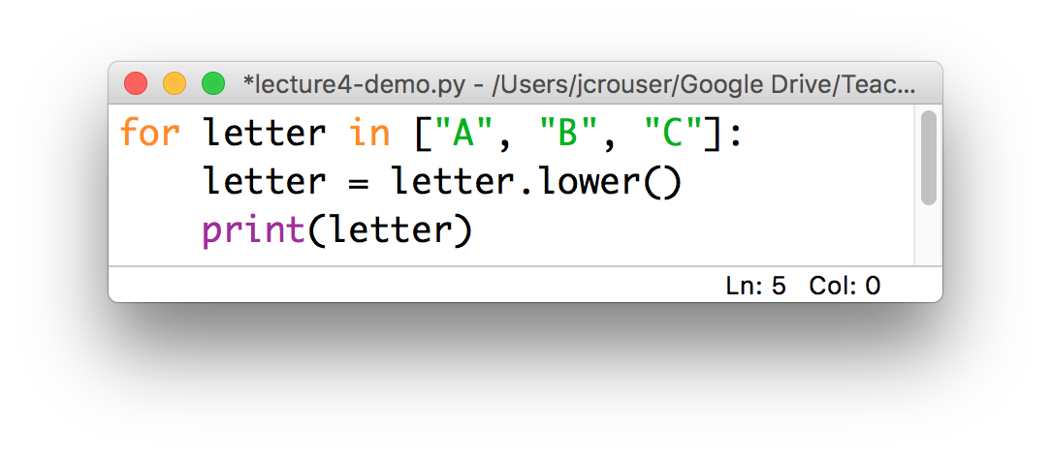
for...in loops: a common “gotcha”
Python will allow you to modify a list while you’re looping through it:
This is generally a bad idea (more on why later)
it’s fine to format the values, etc.
just don’t overwrite the originals!

Slide 15
Demo: compute a sum
Use a for loop to compute
the sum of a list of numbers
Step 1: pseudocode
Step 2: python

Slide 16
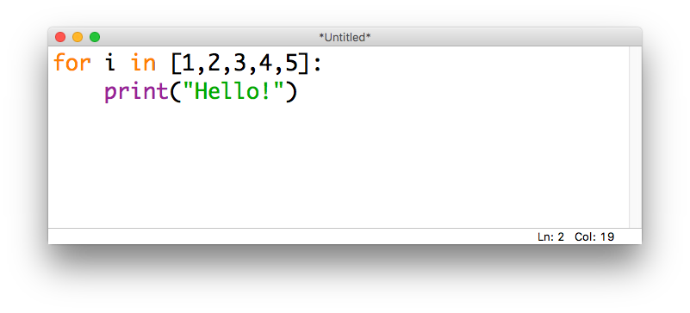
Looping n times
Bad news: there isn’t a way to say “run this loop n times” in Python – we’ll have to find a way around that
If we want a for...in loop to run a specific # of times, can “trick” it using a list of numbers that’s the right size
common
practice:
use the
letter i
to denote
the “index”

Slide 17
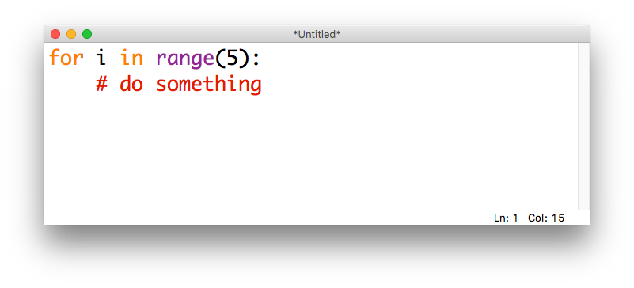
The range() function
The range() function lets us generate lists of integers
Given one integer a, range(a) will generate a list starting at 0 and going up to (but not including) a
For example, if we want a loop to run 5 times:

Slide 18
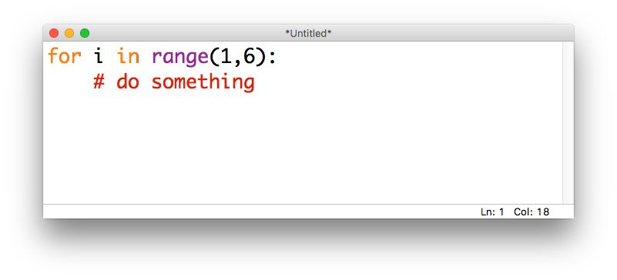
The range() function
Given two integers a,b, range(a,b) will generate a list starting at a and going up to (but not including) b
E.g., if we want to loop over the integers from 1 to 5:

Slide 19
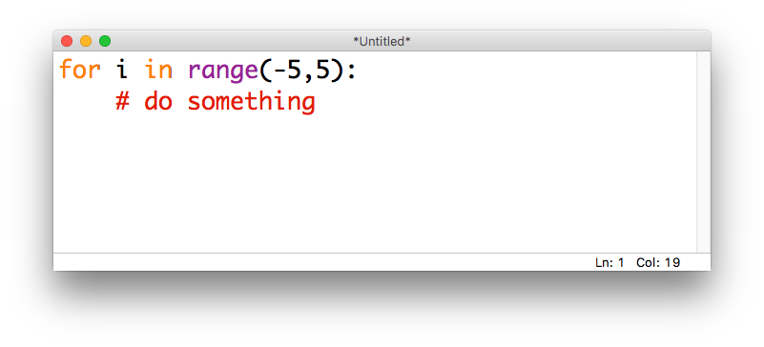
The range() function
These values can be positive or negative (but for now, the second integer should be larger than the first)
E.g., if we want to loop over the integers from -5 to 5:

Slide 20
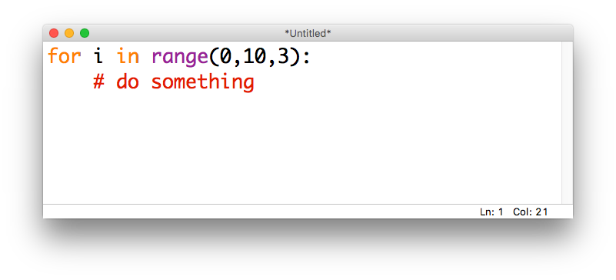
The range() function
Given three integers a,b,c, calling range(a,b,c) will generate a list starting at a and going up to (but not including) b with step size c
E.g., if we want the integers from 0 to 9, counting by 3s:

Slide 21

The range() function
If we want to count down instead of up, we can set b < a and use a negative step size
E.g., if we want to count down from 10 to 1:

Slide 22
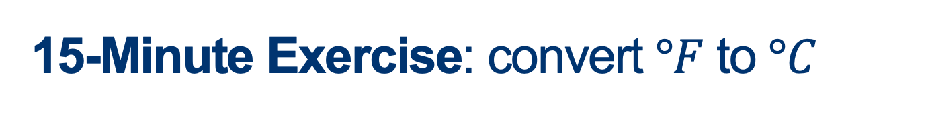
15-Minute Exercise: convert $°F$ to $°C$
Use a for loop and the range() function to generate
a conversion table of temperatures from $°F$ to $°C$
ranging from $100°F$ to $−30°F$ in increments of $10°F$
Tips:
use the formula $°C=(°F−32 ) ∗ 5 / 9$
"{0:.1f}".format(c) will round to 1 decimal place

Slide 23
Discussion
What did you come up with?

Slide 24
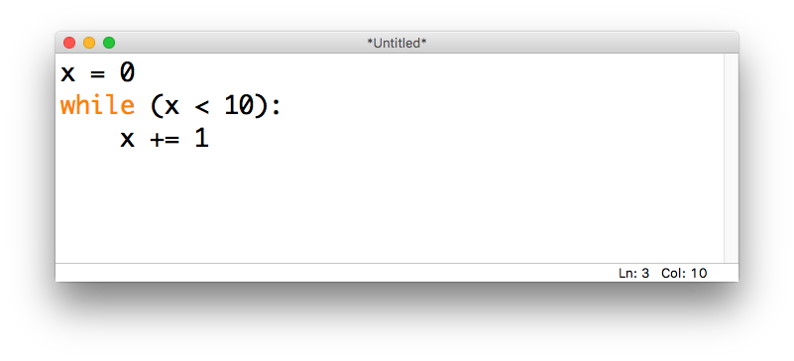
while loops
We may sometimes want a program to continue doing the same thing until something happens
In Python we can do this with a while loop, which is paired with a conditional (True/False) statement

Slide 25
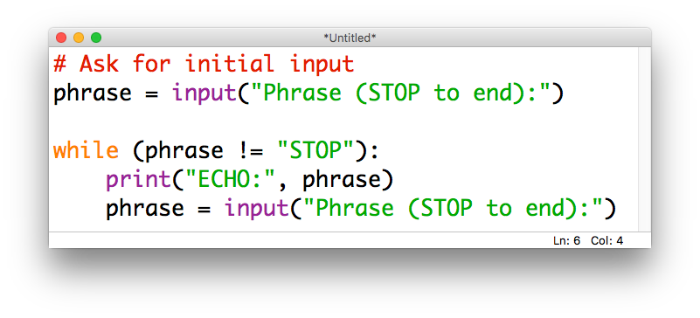
while loops
while loops can be especially useful when combined with the input() function
For example, we may want to continue asking for input until the user tells us they are done:

Slide 26
Demo: compute a sum pt.2
Modify our previous demo program to use a while loop to compute
the sum of a series of numbers
entered by the user
(continue until the user enters a blank)

Slide 27
Checking in
What’s one thing you learned
in today’s class?

Slide 28

Assignment #3: Magic 8 Ball

Slide 29
Assignment #3: Magic 8 Ball
In this assignment, you will write a python program that simulates a Magic 8 Ball
Your program should:
Take in a question from the user
Print a randomly-selected response
Determine if the user wants to ask another question
If so, repeat!
Submit your repl on Moodle by 11:55pm on Thursday

Slide 30
Up next
Monday: Loops
for…in (looping through items in a list)
the range() function (getting a list of numbers)
while (looping until something happens)
Lab: Loops
Wednesday: Life Skill #2/3: Debugging & Documentation
A3 due Thursday at 11:55pm
Friday: Dictionaries and Sets

